Slide 1
EPL Squad Finder
Proof of Concept
Dmytro Yevtushenko
.Net Fullstack Developer

Slide 2
Overview
A web-based proof-of-concept (POC) application that allows users to select any team in the 2024/25 season of the English premier league and return the squad details for that chosen team.
Key features:
Search teams by name or nickname
Manage team nicknames (add/remove custom nicknames dynamically)
Display squad details (photo, name, position, date of birth of player)
Search for players by name and position
Fetch & merge actual data from two different APIs
Store results in a database for quick access
Deploy using CI/CD to Azure
Run locally with Docker Compose for easy development

Slide 3
Tech Stack
Backend | .NET 9, Entity Framework, Mediator, Refit, Polly, FuzzySharp
Frontend | React (Vite), Styled Components
Database | Microsoft SQL Server
Testing | NUnit, AutoFixture, Moq, Shouldly
DevOps | Docker, GitHub Actions, Azure Container Apps

Slide 4
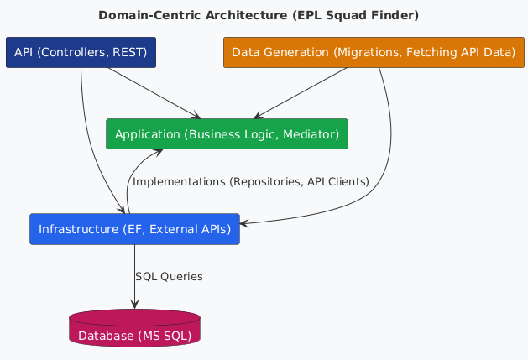
System Architecture
API Layer Handles HTTP requests
Application Layer Business logic (self-contained, independent)
Infrastructure Layer Database + API clients
Data Generation Fetches & processes external data

Slide 5
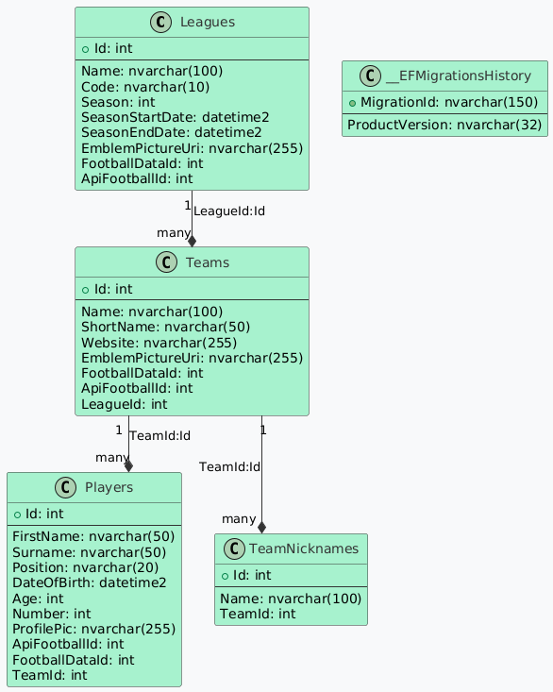
Database Design
Leagues Stores leagues details
Teams Stores teams and their basic info
Players Stores player details
TeamNicknames Stores alternative names for teams

Slide 6
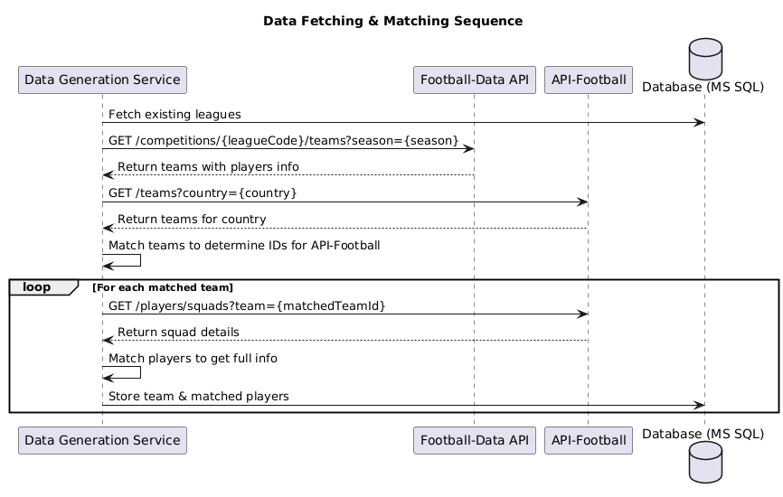
Data Fetching & Matching
https://www.football-data.org
https://api-sports.io/

Slide 7
Matching Algorithm
Players are matched based on name similarity using FuzzySharp.
Each team from Football-Data API is compared against all teams from API-Football using a scoring system:
Criteria | Weight (%) | Matching Method
Exact Name Match | match ration*60% | Fuzzy string comparison
Short Name Match | match ration*40% | Fuzzy string comparison
Three-Letter Code (TLA) Match | +30 points | Exact match
Stadium Name Match | match ration*25% | Fuzzy match (if available)
Youth Team Detection | -50 points | Penalize youth teams

Slide 8
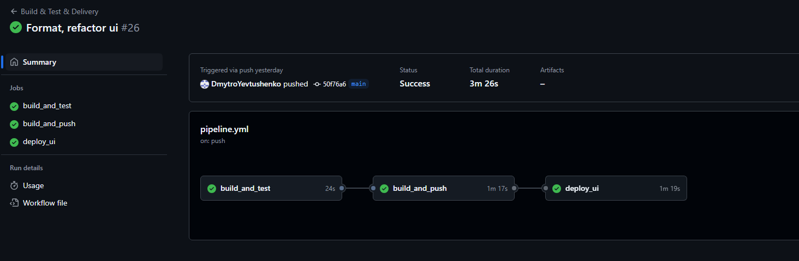
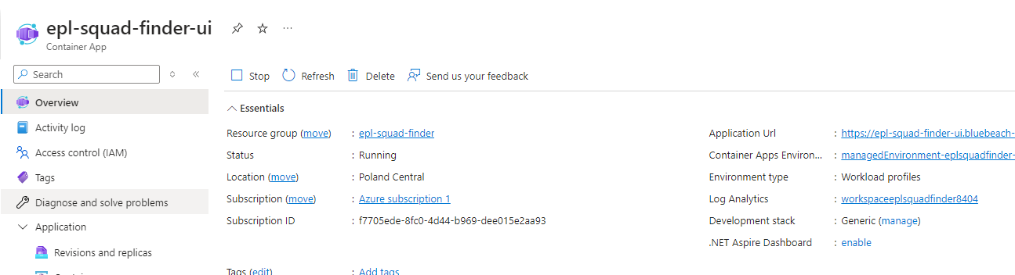
CI/CD & Deployment

Slide 9
Live Demo

Slide 10
Potential improvements
01
03
02
04
Restrict access to nicknames modification
Expand functionality to support multiple leagues, making the system more universal.
Deploy the API and database to Azure to make the application fully cloud-based.
Expand data and add a background service to automatically fetch and update squad data at regular intervals.

Slide 11
Thank you! Questions?

